Slide 1
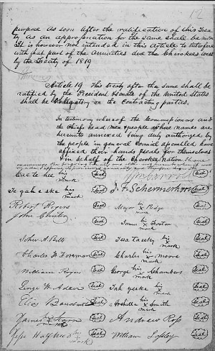
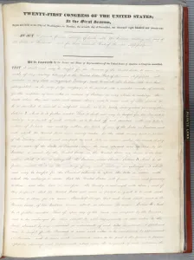
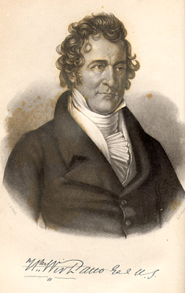
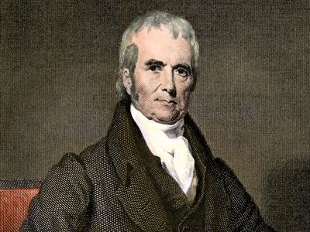
Trail of Tears:
Treaties, Laws, and Controversies
Cherokee Controversies
Treaty of New Echota- December 1835, this treaty was signed by a minority of 20 pro-removal Cherokees, while Chief John Ross was not in attendance.
The treaty was started because the United States Government signed the Indian Removal Act into law in 1830. This caused a minority of 20 pro-removal Cherokees including Major Ridge to get together and form the Treaty of New Echota. Due to the way that the treaty was made by the year 1838 only 2,000 Cherokee had made their way West.
Andrew Jackson could be seen in a controversial way to some as he worked with the Cherokee during the Creek War in 1813 and did a complete 180 in his beliefs toward the Cherokee. This was because it was of the common interest of the American people.
US Government Controversies
In the year 1828, Governor John Forsyth of Georgia signed a law allowing the state to have jurisdiction over the Cherokee land. John Ross and some other Cherokee leaders with John Ross carried a case to the Supreme Court saying that Georgia did not have jurisdiction over the Cherokee land. William Wirt a former U.S. attorney general represented the Cherokee in the Supreme Court. In this case, called Worcester v. Georgia, the court declared 5 to 1 by John Marshall the Georgia law as null and void. This was overruled though with the Treaty of New Echota and the Indian Removal Act that was later enforced in 1838 by Martin Van Buren.
President Andrew Jackson strongly advocated for the movement of the Indian Removal Act, which should not be looked over when discussing the passing of the law.
On May 25,1836, Andrew Jackson signed an act that authorized 10,000 volunteer troops to the Cherokee Nation.
John Marshall
William Wirt

Slide 2
Bibliography
Davis, Kenneth. " The Cherokee Removal." Tennessee Historical Quarterly Vol.32, No.4 (1973),pp.311-331
Dinwoodie, Jane. "Evading Indian Removal in the American South." Journal of American History (2021)
Vipperman, Carl. " The Bungled Treaty of New Echota: The Failure of Cherokee Removal, 1836-1838." The Georgia Historical Quarterly Vol.73, No.3 (1989), pp.540-558
“The Treaty of New Echota and the Trail of Tears.” NC Department Of Natural and Cultural Resources, www.dncr.nc.gov/blog/2016/12/29/treaty-new-echota-and-trail-tears.
“On Exhibit: the Indian Removal Act.” National Archives, Pieces of History, prologue.blogs.archives.gov/2017/03/16/on-exhibit-the-indian-removal-act.
“John Marshall.” Encyclopædia Britannica, November 8, 2024. https://www.britannica.com/biography/John-Marshall.
William Wirt, MSA SC 3520-2162. Accessed December 2, 2024. https://msa.maryland.gov/msa/speccol/sc3500/sc3520/002100/002162/html/msa02162.html.

